Slide 1

Chapter 2
Instructions: Language of the Computer
Notes:
The University of Adelaide, School of Computer Science
Chapter 2 — Instructions: Language of the Computer

Slide 2

Logical Operations
Instructions for bitwise manipulation
§2.6 Logical Operations
Operation | C | Java | MIPS
Shift left | << | << | sll
Shift right | >> | >>> | srl
Bitwise AND | & | & | and, andi
Bitwise OR | | | | | or, ori
Bitwise NOT | ~ | ~ | nor
Useful for extracting and inserting groups of bits in a word
Chapter 2 — Instructions: Language of the Computer — <number>
Notes:
The University of Adelaide, School of Computer Science
Chapter 2 — Instructions: Language of the Computer

Slide 3
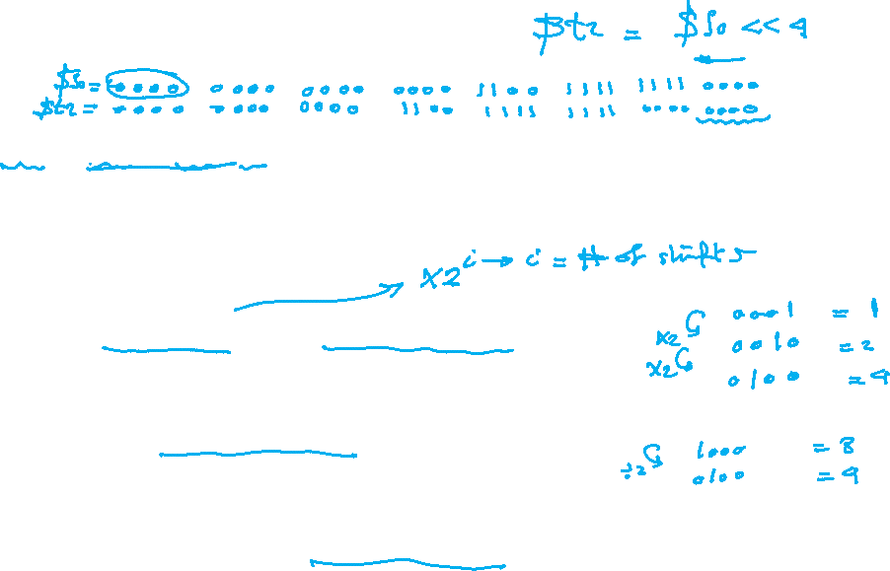
Shift Operations
sll $t2,$s0,4 # reg $t2 = reg $s0 << 4 bits
shamt: how many positions to shift
Shift left logical
  Shift left and fill with 0 bits
  sll by i bits multiplies by 2^{i}
Shift right logical
  Shift right and fill with 0 bits
  srl by i bits divides by 2^{i} (unsigned only)
Chapter 2 — Instructions: Language of the Computer — <number>
Notes:
The University of Adelaide, School of Computer Science
Chapter 2 — Instructions: Language of the Computer

Slide 4
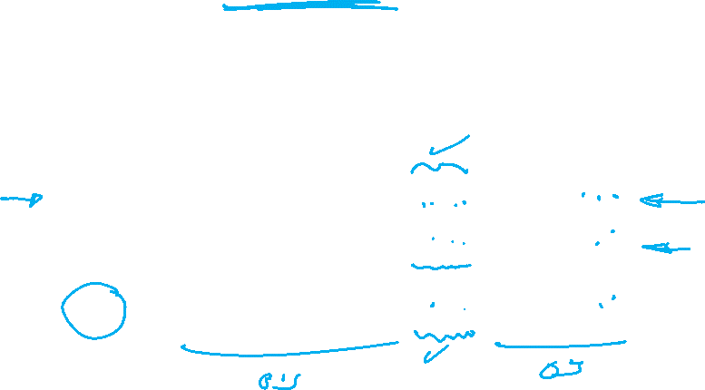
AND Operations
Useful to mask bits in a word
  Select some bits, clear others to 0
and $t0, $t1, $t2
$t2
0000 0000 0000 0000 0000 1101 1100 0000
$t1
0000 0000 0000 0000 0011 1100 0000 0000
$t0
0000 0000 0000 0000 0000 1100 0000 0000
Chapter 2 — Instructions: Language of the Computer — <number>
Notes:
The University of Adelaide, School of Computer Science
Chapter 2 — Instructions: Language of the Computer

Slide 5

OR Operations
Useful to include bits in a word
  Set some bits to 1, leave others unchanged
or $t0, $t1, $t2
$t2
0000 0000 0000 0000 0000 1101 1100 0000
$t1
0000 0000 0000 0000 0011 1100 0000 0000
$t0
0000 0000 0000 0000 0011 1101 1100 0000
Chapter 2 — Instructions: Language of the Computer — <number>
Notes:
The University of Adelaide, School of Computer Science
Chapter 2 — Instructions: Language of the Computer

Slide 6
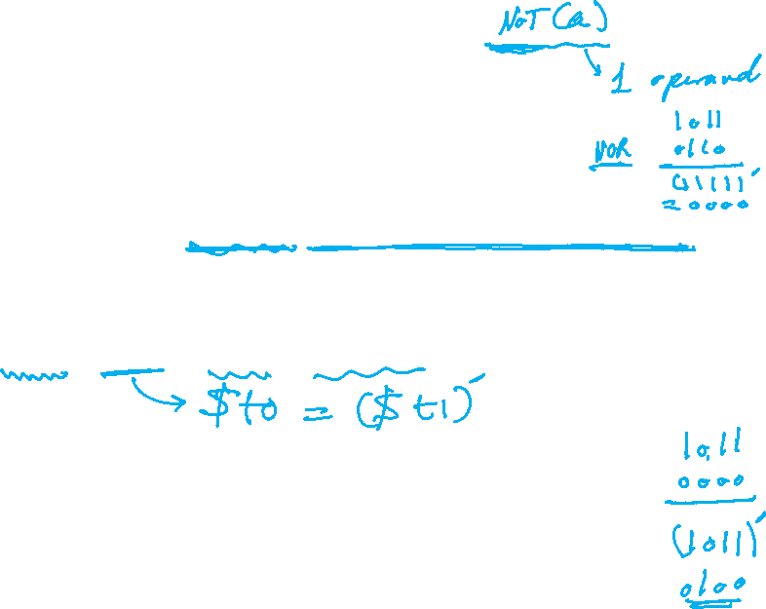
NOT Operations
Useful to invert bits in a word
  Change 0 to 1, and 1 to 0
MIPS has NOR 3-operand instruction
  a NOR b == NOT ( a OR b )
nor $t0, $t1, $zero
Register 0: always read as zero
$t1
0000 0000 0000 0000 0011 1100 0000 0000
$t0
1111 1111 1111 1111 1100 0011 1111 1111
Chapter 2 — Instructions: Language of the Computer — <number>
Notes:
The University of Adelaide, School of Computer Science
Chapter 2 — Instructions: Language of the Computer

